Slide 1
Assignment 2
Machine learning with Energy datasets
By: Team 5
Akash Jagtap
Jerin Rajan
Nitin Prince Reuben

Slide 2
Introduction
The purpose of this assignment was to understand concepts of machine learning by using dataset which contains details of energy usage. Performing different algorithms, performing different tests like cross-validation, regularization, etc. which will help us analyze a dataset much more clearly.

Slide 3
Part 1: Research
Paper 1: The energy consumption of various appliances was analysed and compared different models with their RMSE or Rsquare.
Paper 2: This research paper shows difference between ensemble and single SVM models
Paper 3: Purpose of this paper was to understand the concept of smart grid. How important it is to predict the consumption of electricity for the next day

Slide 4
Part 2: Exploratory Data Analysis
Data - https://github.com/LuisM78/Appliances-energy-prediction-data
Data can be found in ‘csv’ file. It has data of temperature details and humidity details of 9 rooms inside the house. It also consist data like windspeed , visibility , temperature outside and pressure. Data has to be analyzed before proceeding for performing predictions with algorithms.

Slide 5
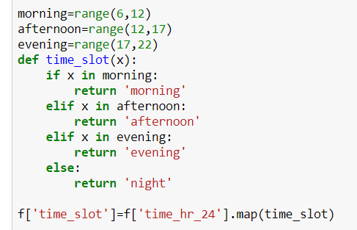
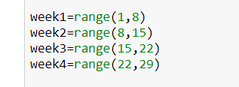
We are diving the time into four groups. Morning, afternoon, evening and night. In the same way, we are categorizing the days into weeks as first 7 days are week 1, 2nd 7 days are week 2 and so on. This is just categorizing of data which would help us analyze data easily.

Slide 6
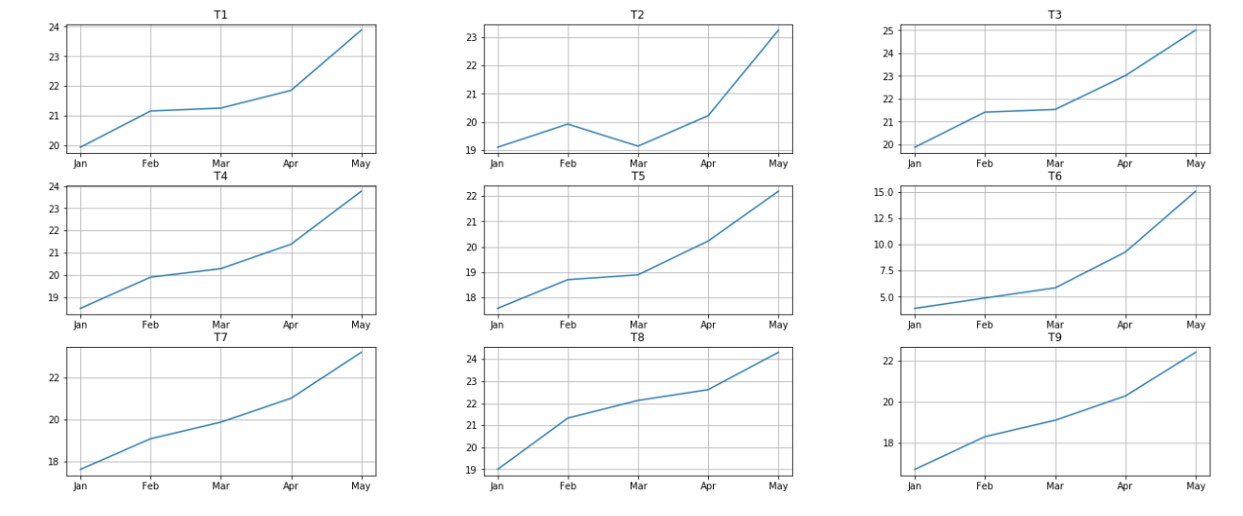
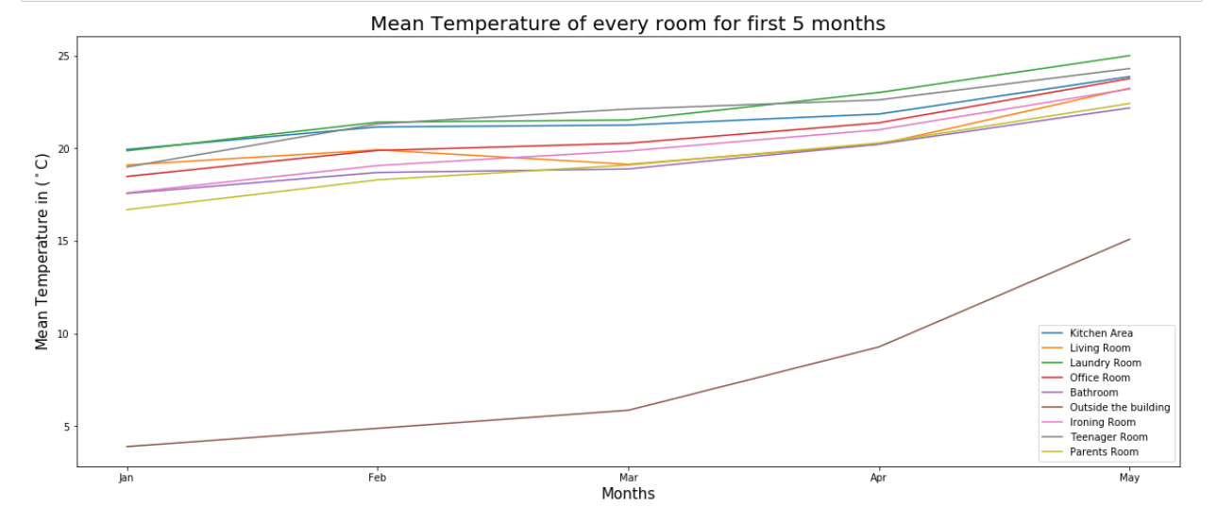
Change of mean temperature over the period
Change of mean temperature over the period

Slide 7
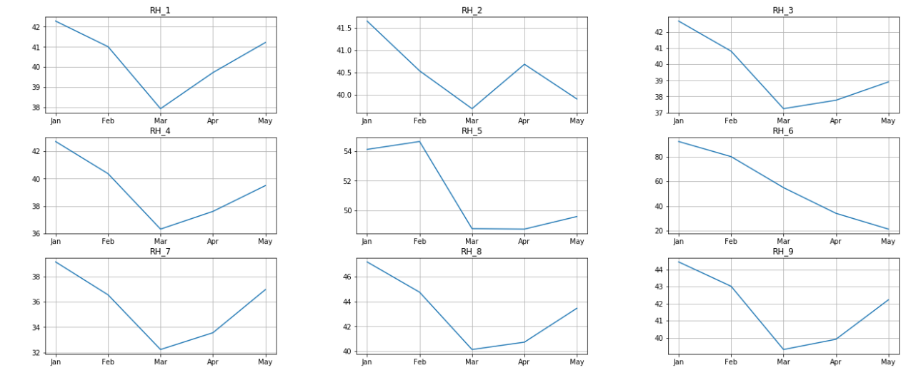
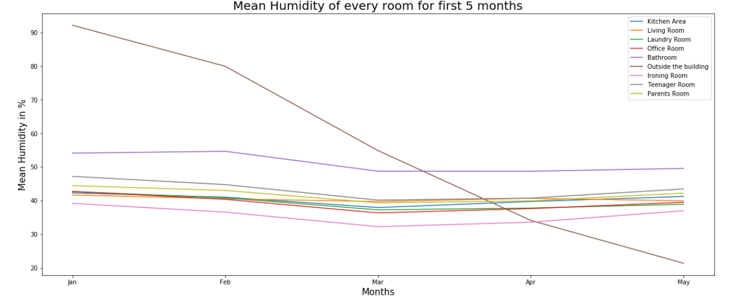
Change of mean Humidity over the period

Slide 8
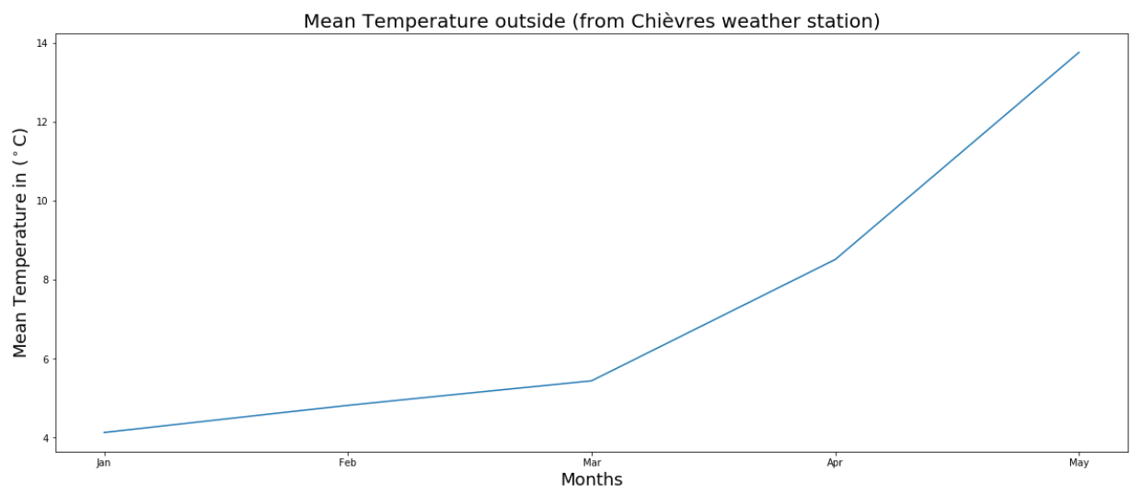
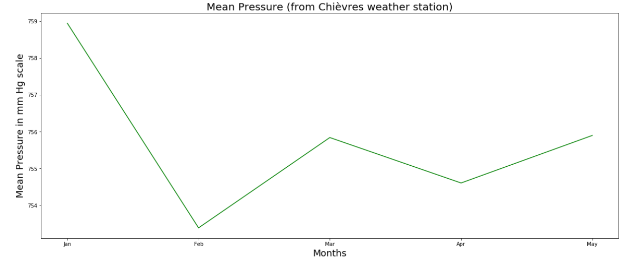
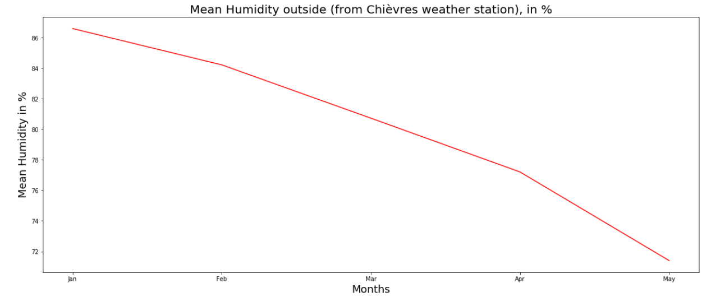
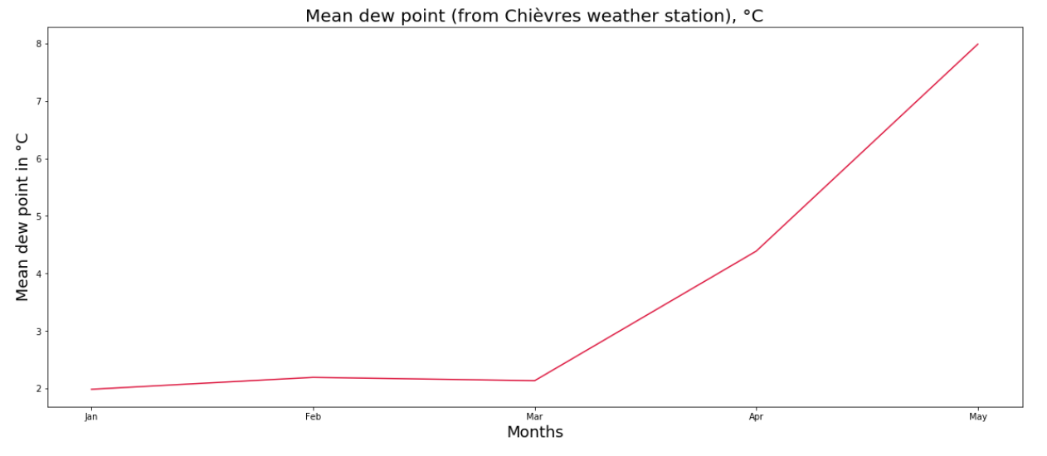
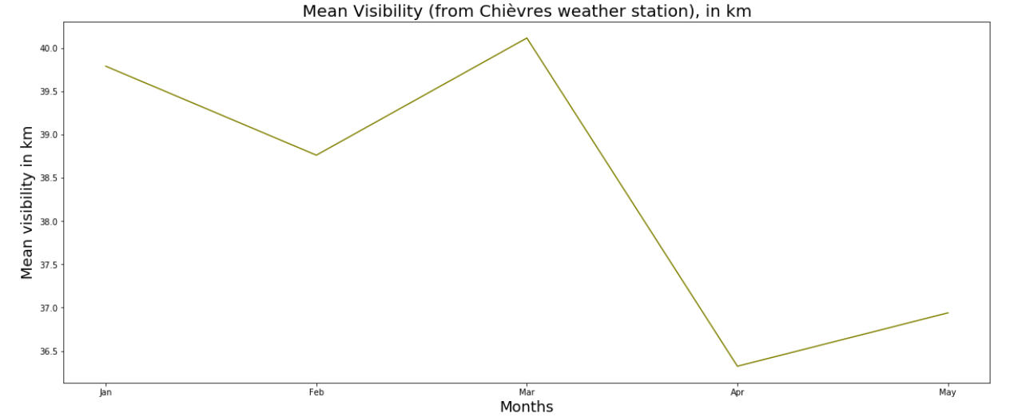
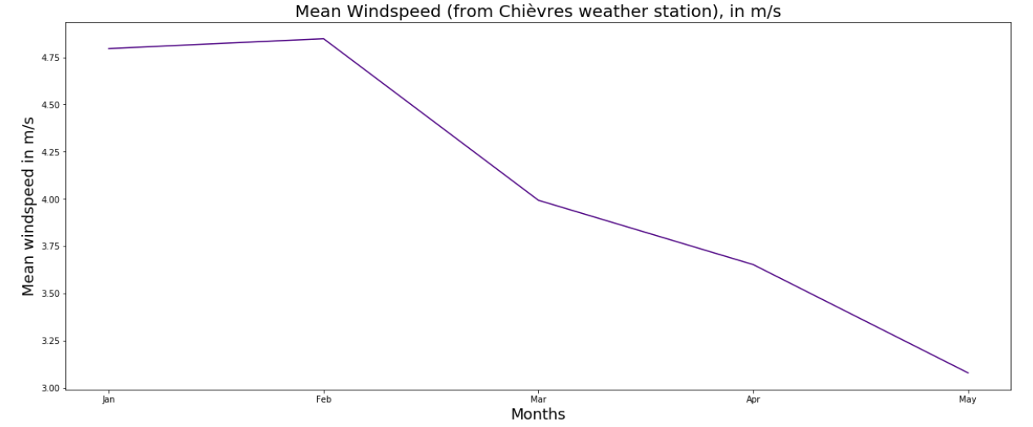
Change of mean of Other Features over the period

Slide 9
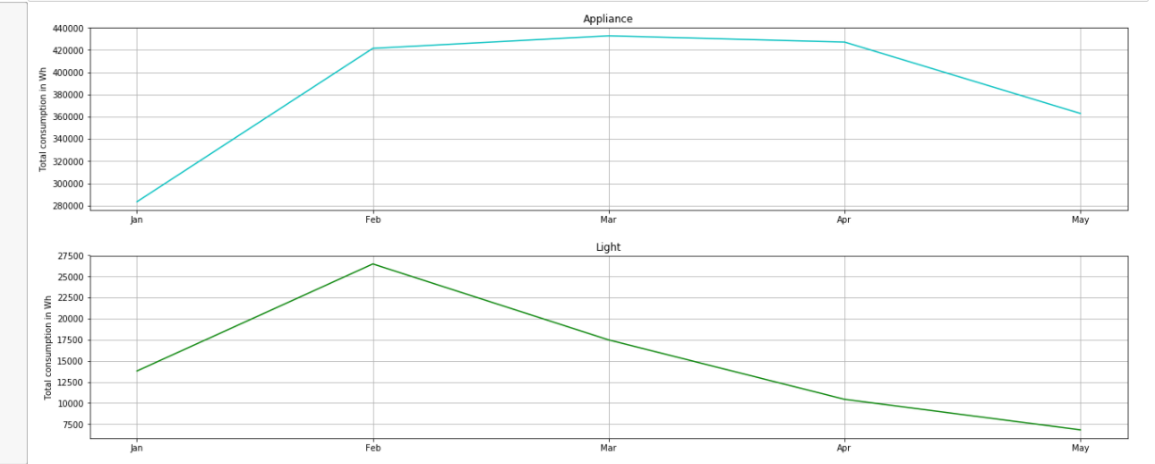
Total consumption of Energy

Slide 10
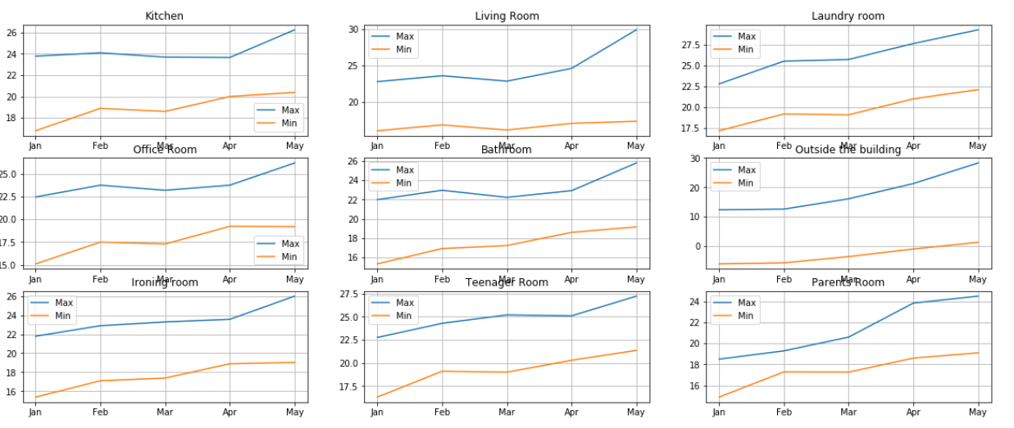
Min-Max Temperature

Slide 11
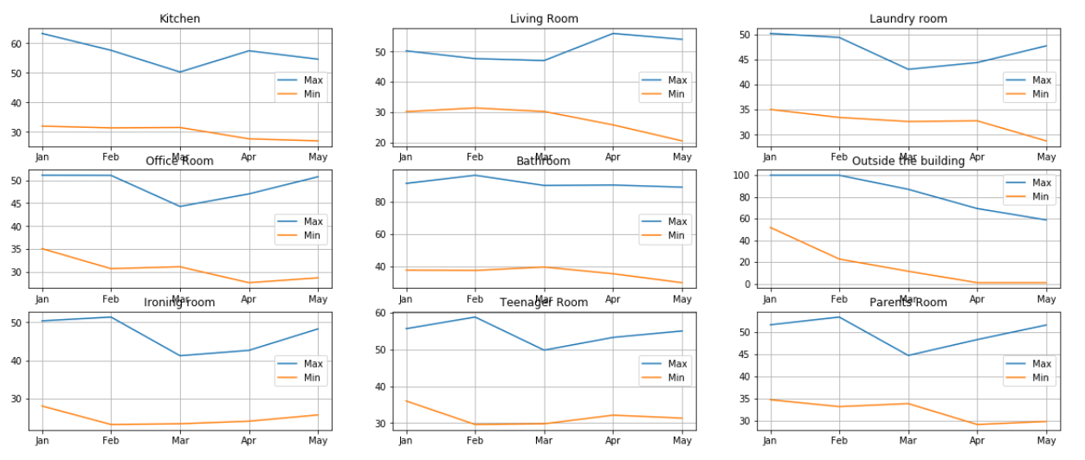
Min-Max Humidity

Slide 12
It is important to understand the change in mean of temperature with respect to others and over the period. So, we are comparing mean of temperature in 3 rooms at one time with months.

Slide 13
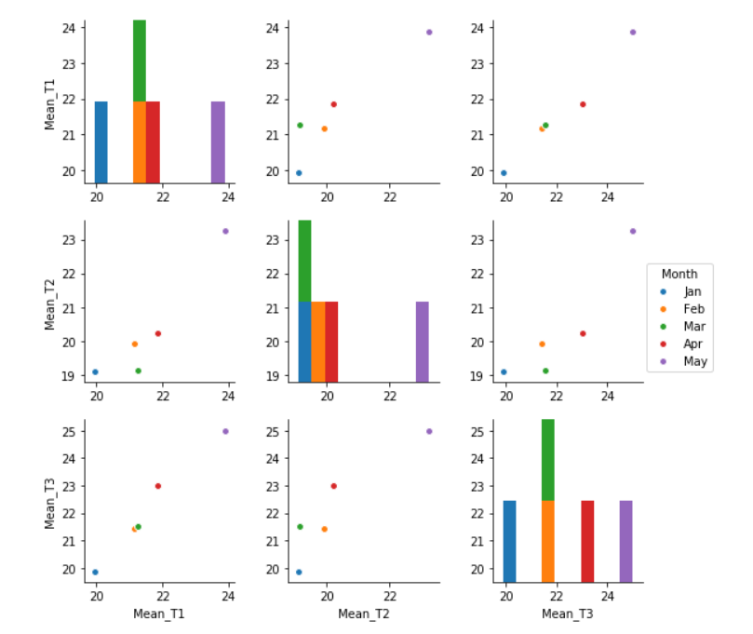
Mean Temperature w.r.t to other rooms

Slide 14
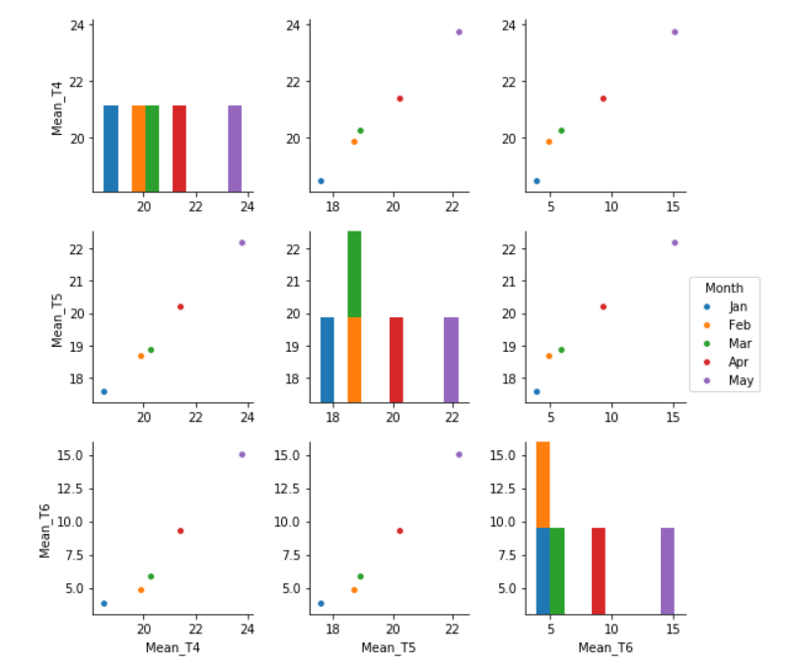
Mean Temperature w.r.t to other rooms

Slide 15
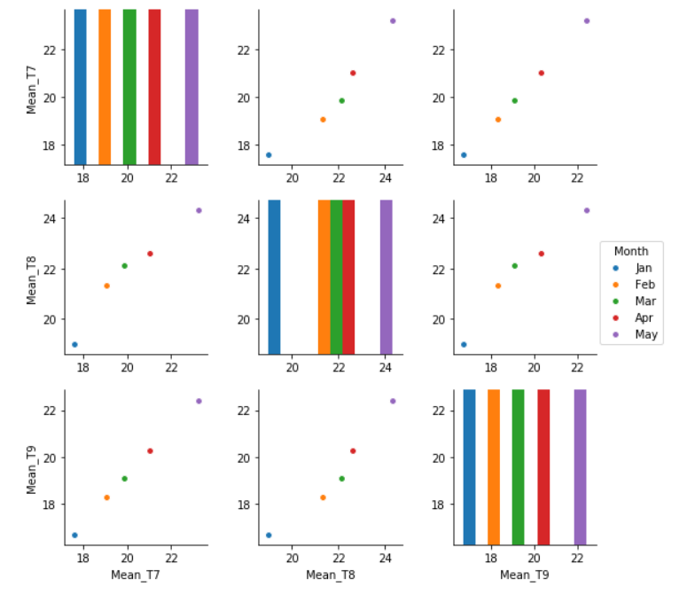
Mean Temperature w.r.t to other rooms

Slide 16
Similarly, comparing the change in mean of humidity of 3 room at a time with respect to months.

Slide 17
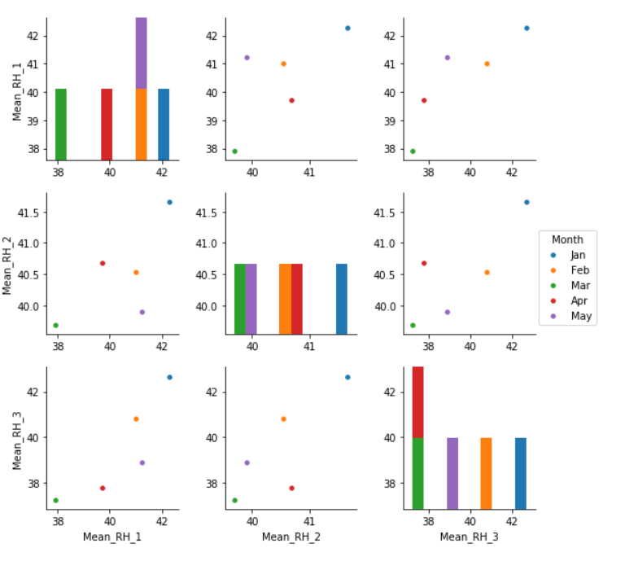
Mean Humidity w.r.t to other rooms

Slide 18
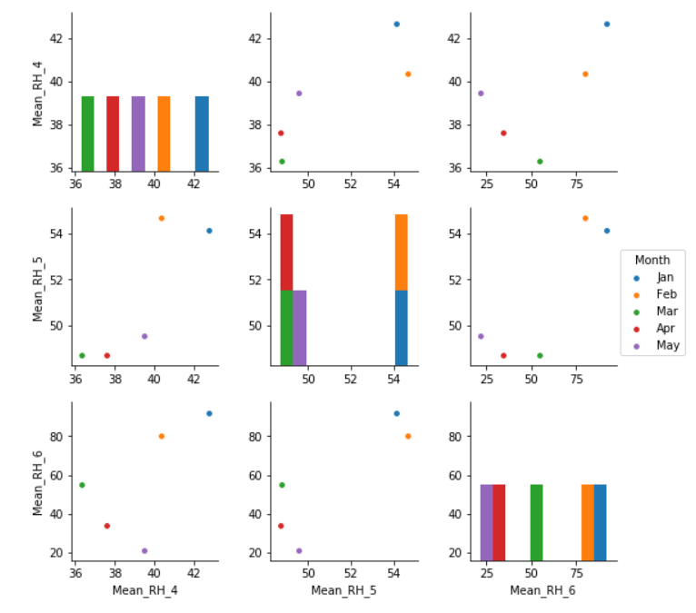
Mean Humidity w.r.t to other rooms

Slide 19
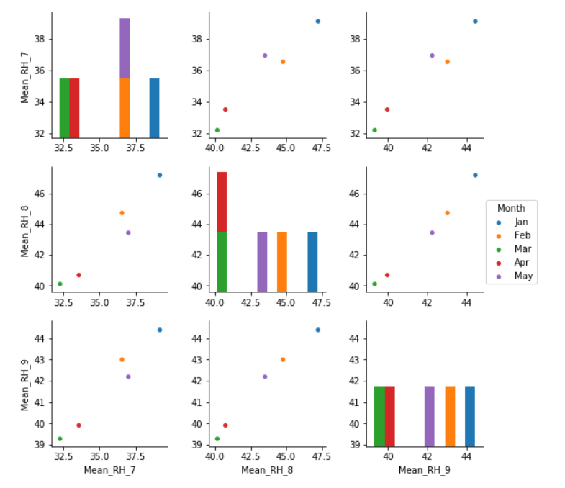
Mean Humidity w.r.t to other rooms

Slide 20
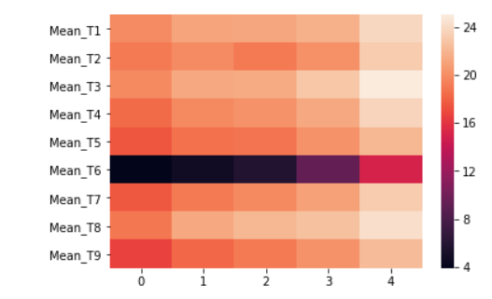
Heat Map
Let's try to understand the pattern of change in mean temperature through a heat map.

Slide 21
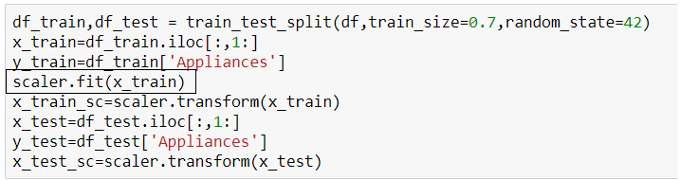
Part 3: Feature engineering
Scaling

Slide 22
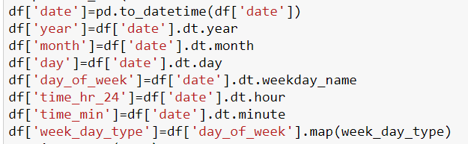
Derived Features and Dummy Columns

Slide 23
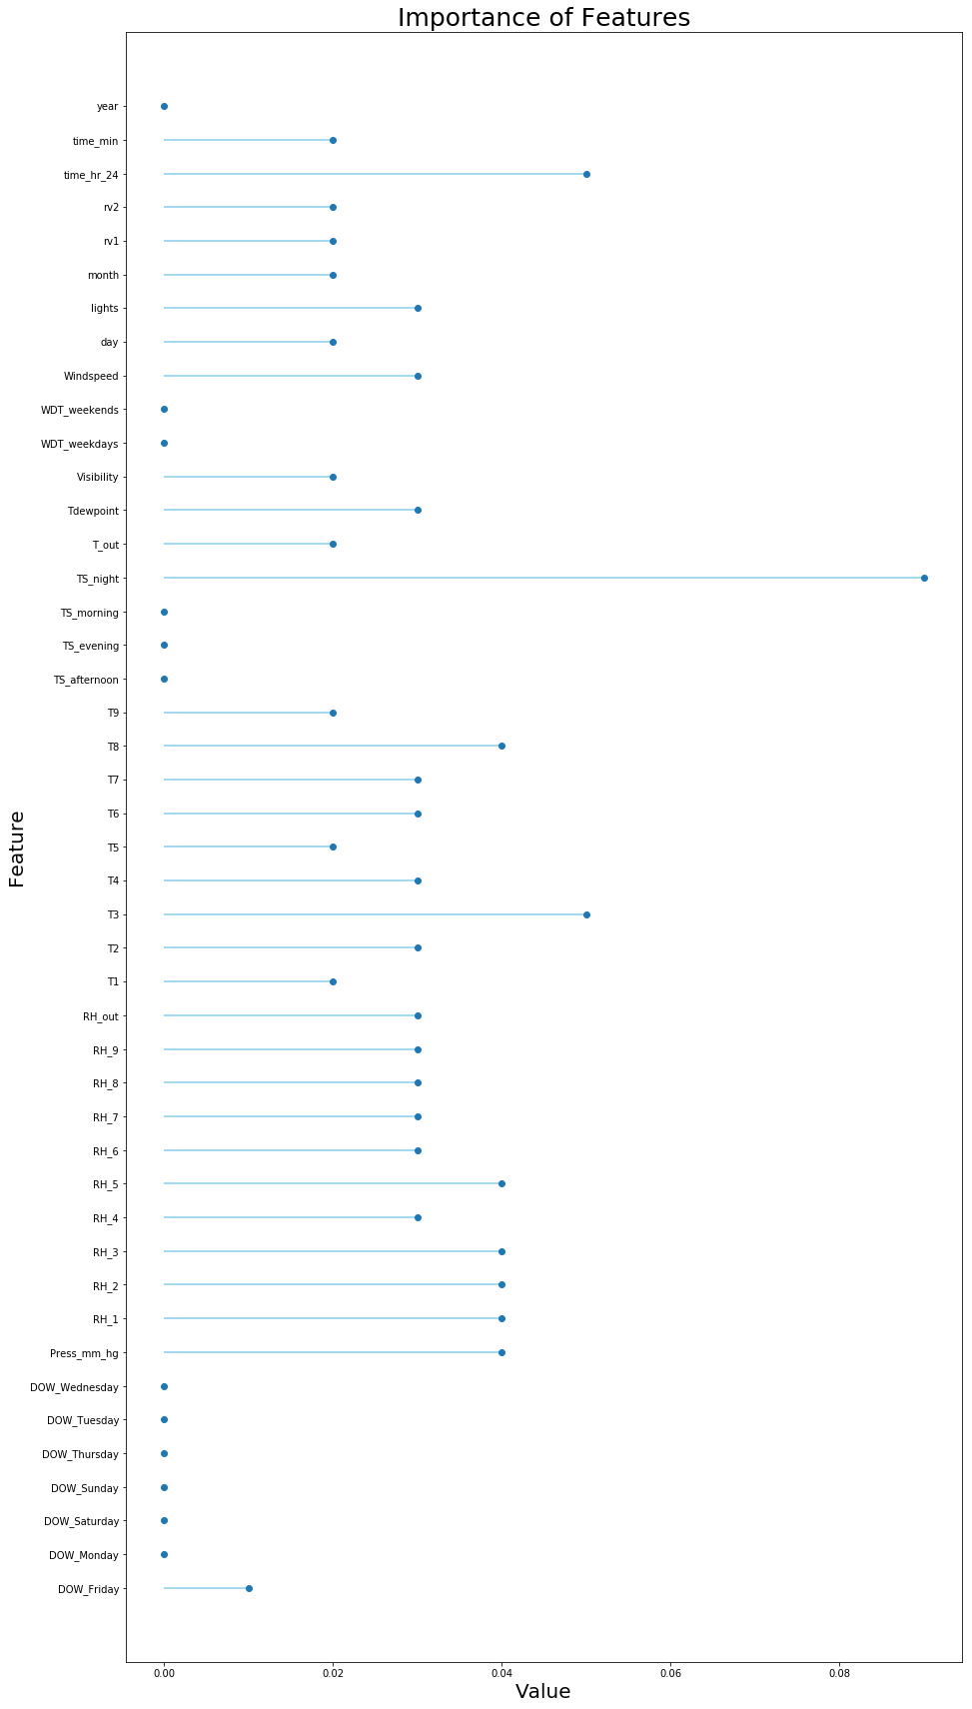

Slide 24
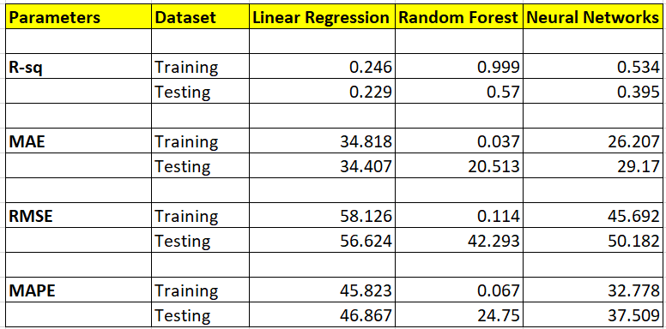
Part4- Prediction algorithms

Slide 25
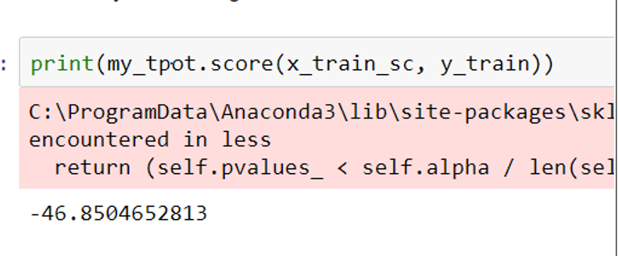
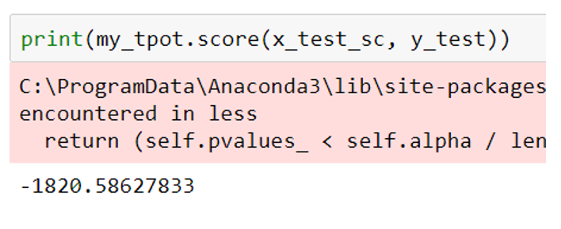
Part5 - Feature Selection

Slide 26
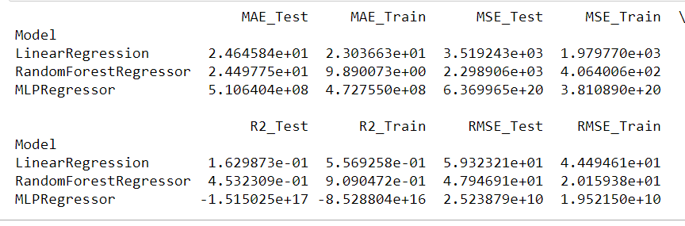
TSFresh

Slide 27
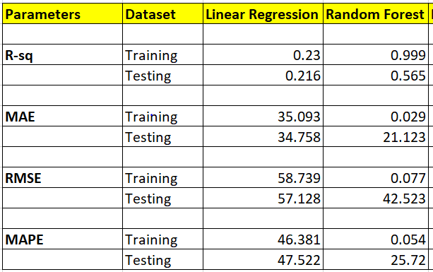
Boruta

Slide 28
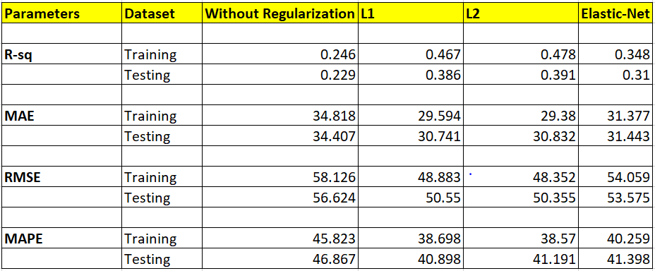
Part6 - Model Validation and Selection

Slide 29
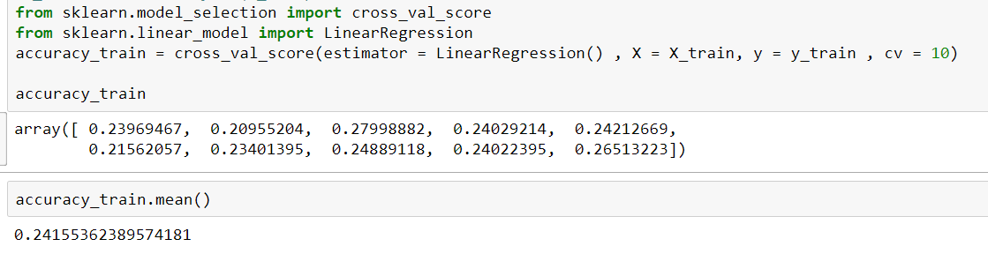
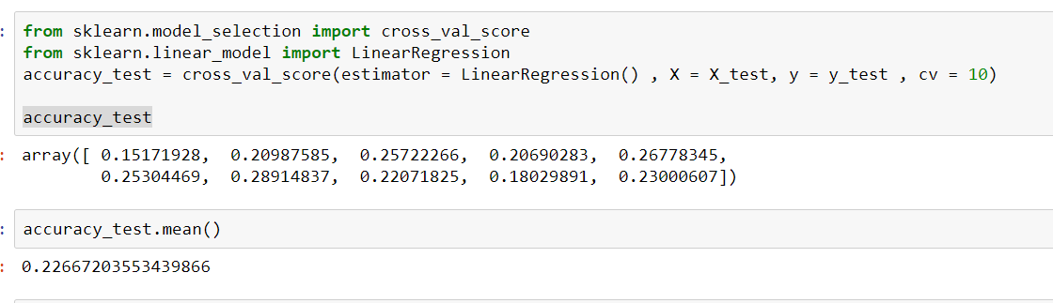
Cross -Validation

Slide 30
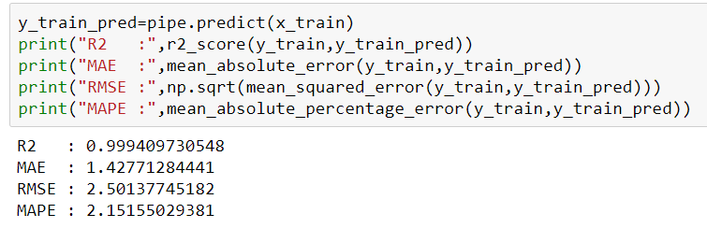
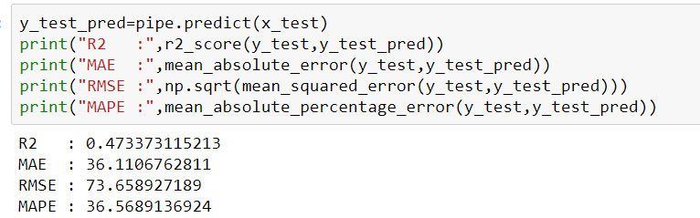
Part 7: Final pipeline

Slide 31
Conclusion
Model:- Random Forest
Feature Selection:- Boruta
Regularization:- L2

Slide 32
Thank You

